Slide 1
CPSC 597 Checking Point 3
A Web Application Integrating an AI-Based Intrusion Detection System
for Network Traffic Analysis
Vinh Tran

Slide 2
Contents
Machine Learning Models Selection
Achievements
Implement the logic and notifications
Implement APIs in the server
Design UIs for dashboard and analysis result pages
Limitations and Future Plans
Demo/ Demonstration

Slide 3
1. Machine Learning Models Selection
Models | Accuracy Score | Weighted F1-Score | Macro F1-Score
K-NN | 0.699 or 69.9% | 0.73 | 0.41
Decision Tree | 0.698 or 69.8% | 0.72 | 0.44
Support Vector Machine | 0.68 or 68.0% | 0.70 | 0.34
Random Forest | 0.75 or 75.0% | 0.78 | 0.45
XGBoost | 0.766 or 76.6% | 0.78 | 0.51

Slide 4
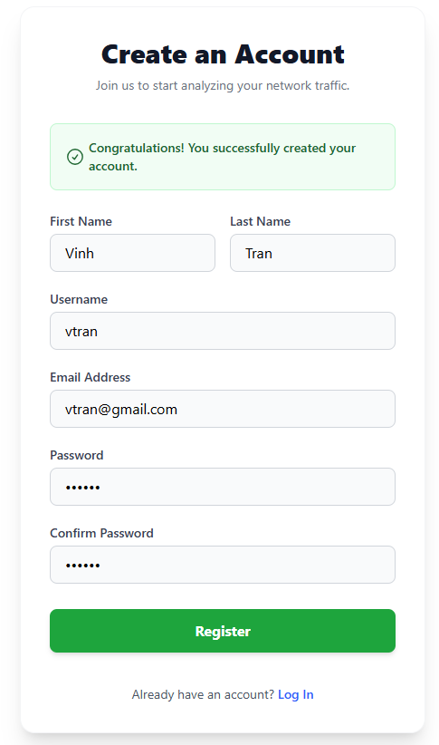
2. Logic and Notifications on Creating a New Account

Slide 5
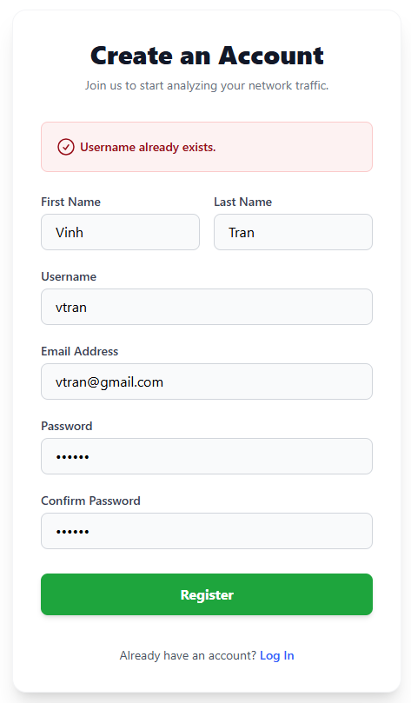
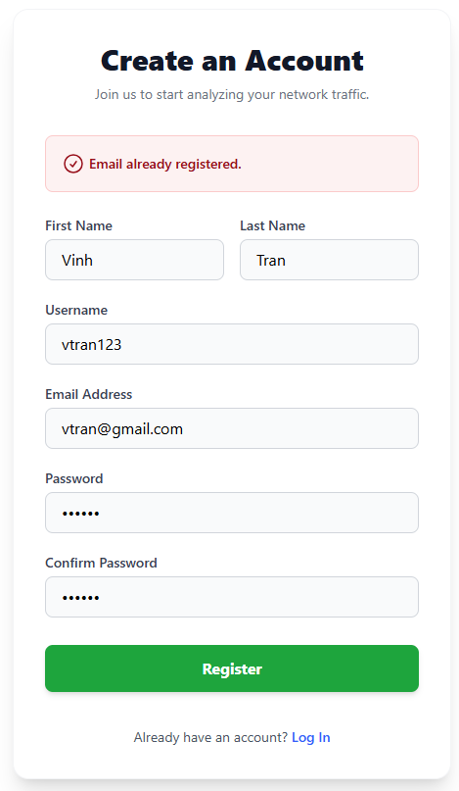
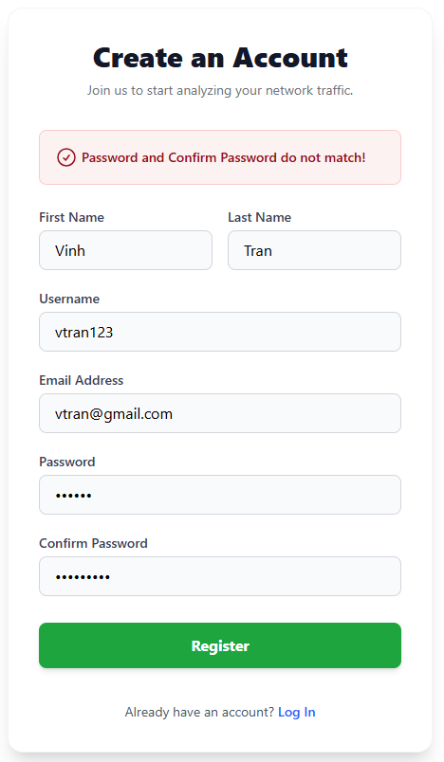
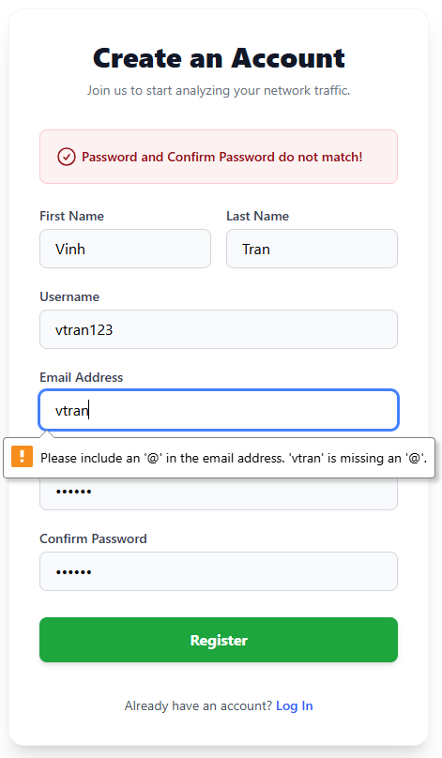
2. Logic and Notifications on Creating a New Account

Slide 6
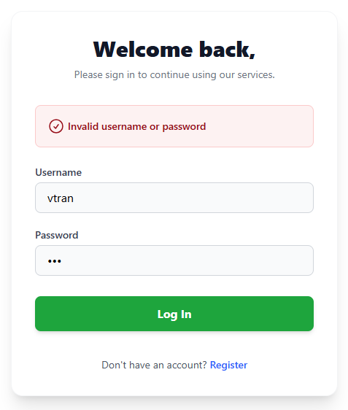
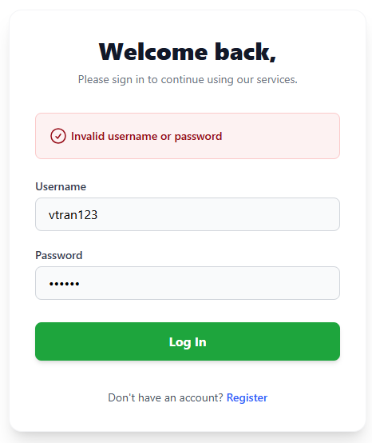
2. Logic and Notification on Logging In The Website

Slide 7
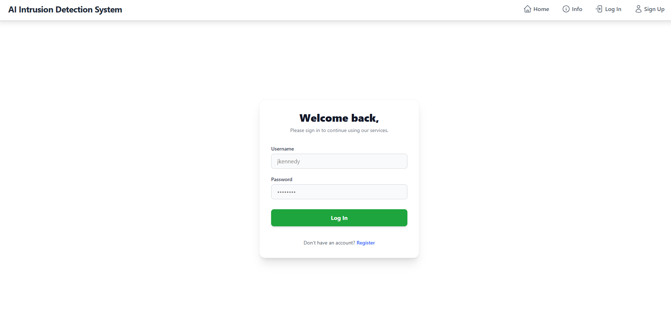
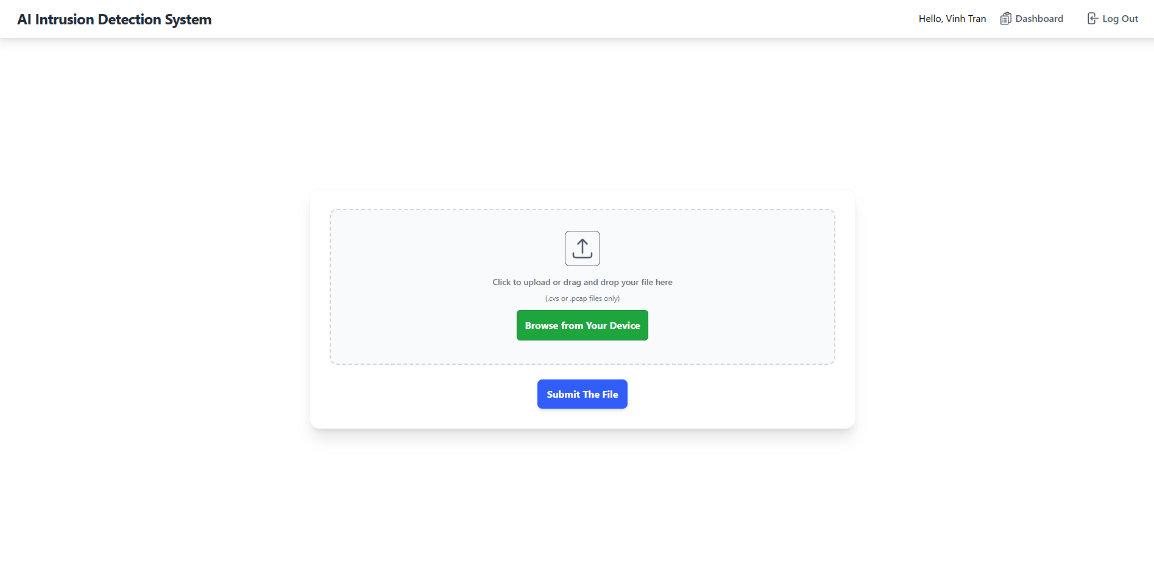
2. Logic on Keeping Track of The Logging Status

Slide 8
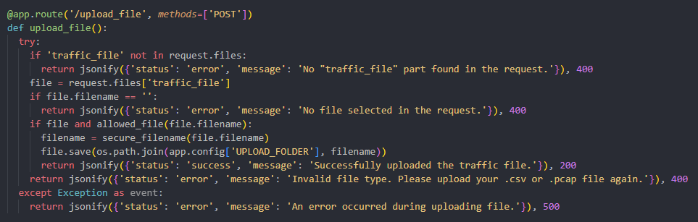
2. /upload_file API

Slide 9
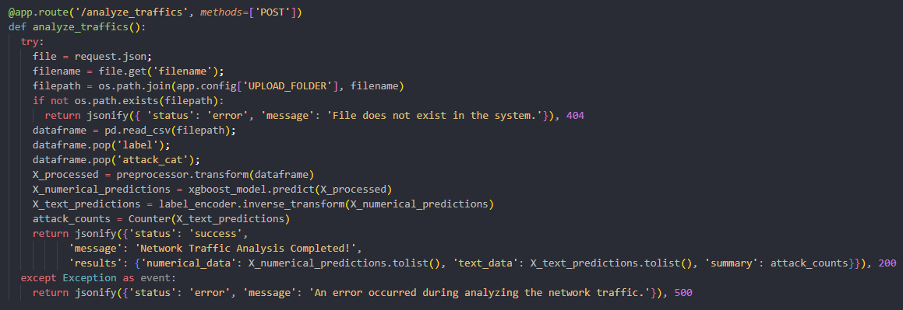
2. /analyze_traffics API

Slide 10
2. UI for Dashboard

Slide 11
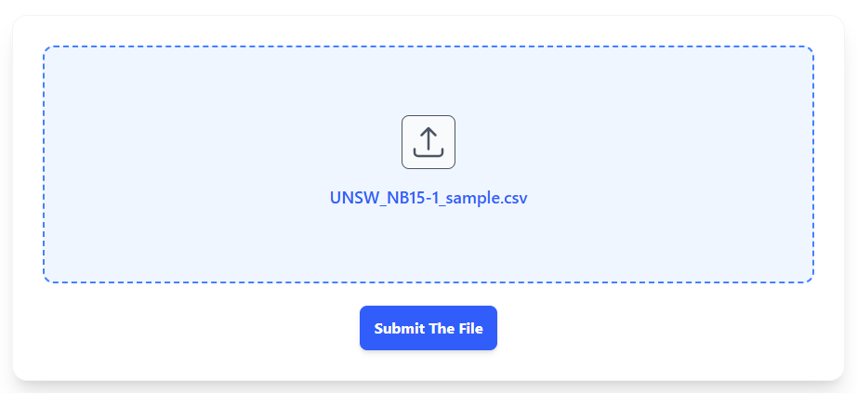
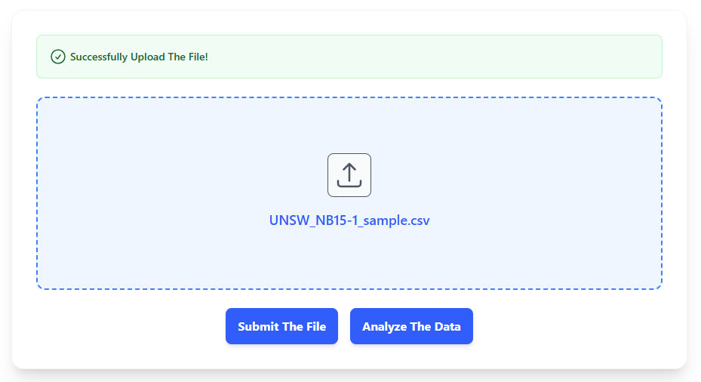
2. Logic and Notifications for Uploading The File

Slide 12
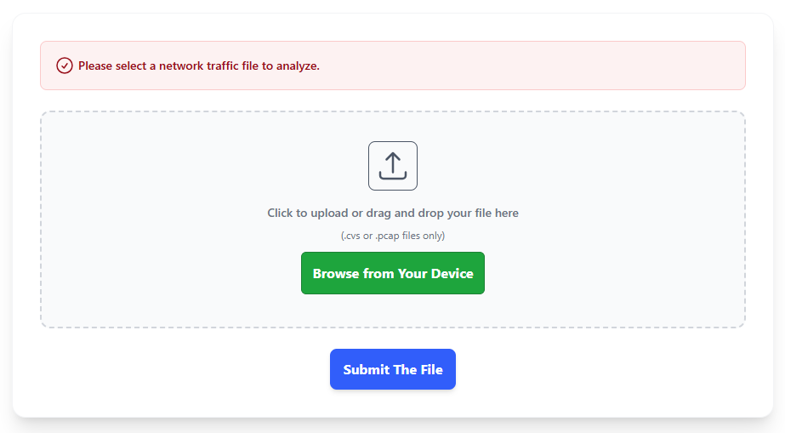
2. Logic and Notifications for Uploading The File

Slide 13
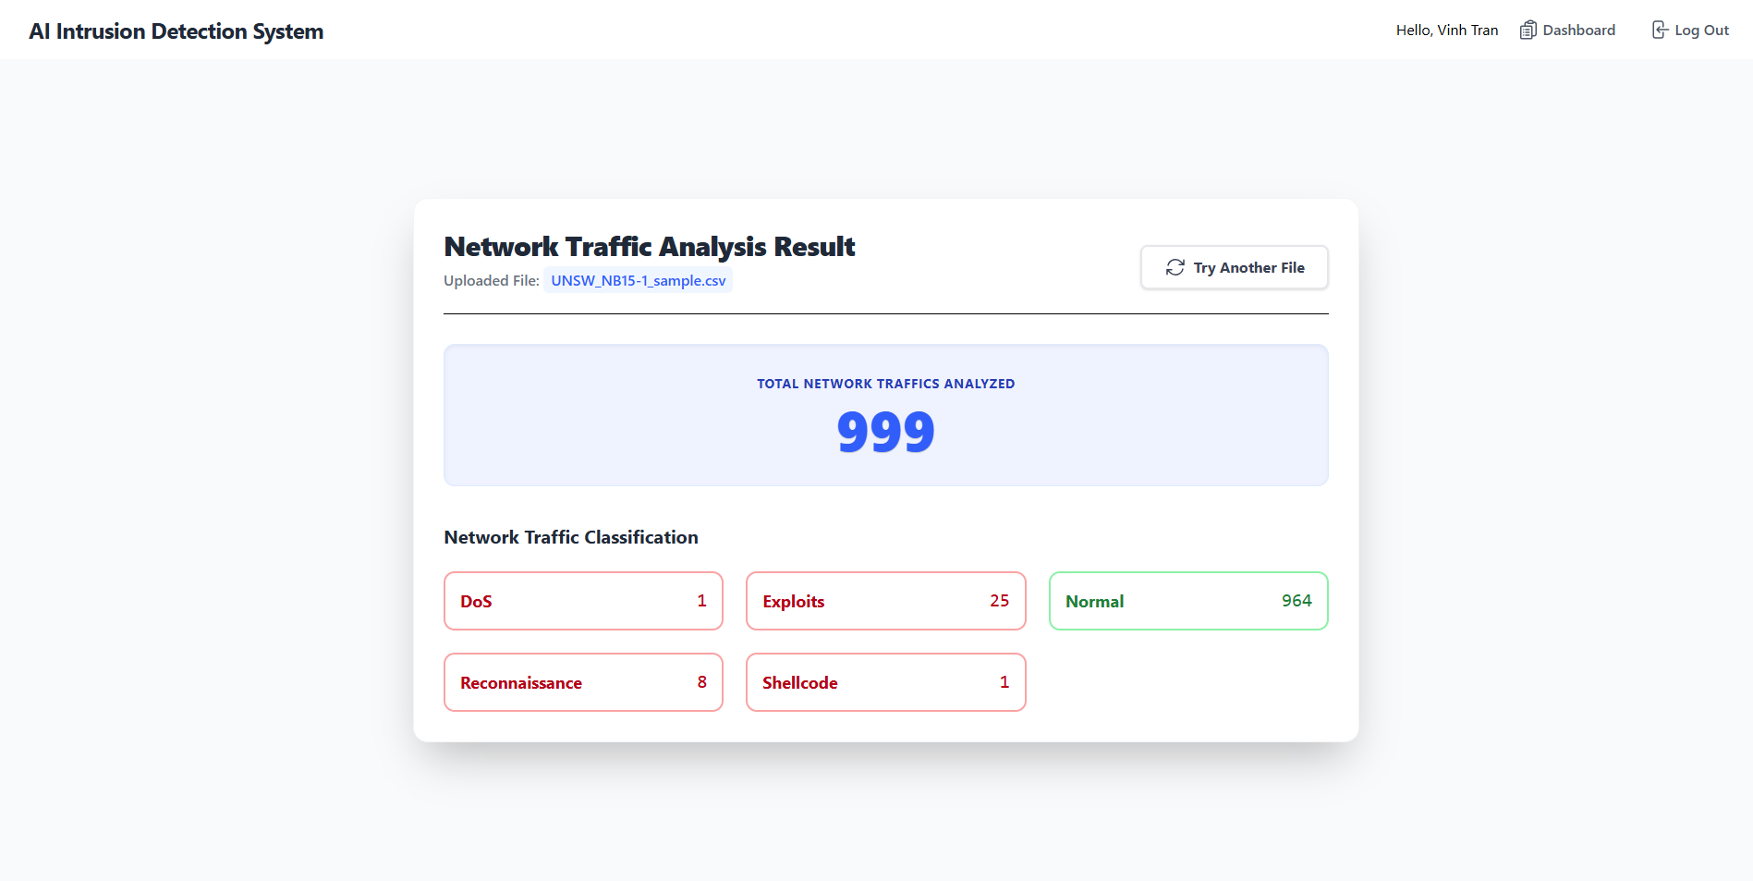
2. UI for Analysis Report

Slide 14
3. Limitations and Future Plans
Limitations:
Only analyze the data from .csv file now
Only work well if the .csv file is formatted the same as the training/testing dataset
Future Plans:
Design the UI for the Info page
Continue working on the solution so that the application can perform the analysis on most files
Detect and fix bugs if any
Update and complete the contents for Final Project Report

Slide 15
4. Demo/ Demonstration

